Slide 1
Geoportfolio presentation
Professional Practice (GEOM2116)
Nicholas Lee

Slide 2
Job opportunity
Please let your students know that if they're passionate about GIS work, we'd love to meet them. We've got casual roles available and the potential for full-time positions down the line.
For more information they are more than welcome to get in contact with me:
Alex.pavis@tetratech.com
Alex Pavis | LinkedIn
Or our GIS lead Grant Young:
Grant.young@tetratech.com
Grant Young | LinkedIn
Ph: 0409174108

Slide 3


What you need
A working computer
Visual Studio Code: https://code.visualstudio.com/Download
GitHub: https://github.com/
An HTML and CSS file ready to go.
Any images you want on your Geoportfolio saved in the same folder as your HTML and CSS files.

Slide 4

Getting started
On Visual Studio Code, go to File→New Text File.
In the new file, click on “fill with template” and select “HTML doc”
Repeat the step of File→New Text File but instead press “Select a language” and click on CSS
You should have two files ready: the HTML file and the CSS file

Slide 5
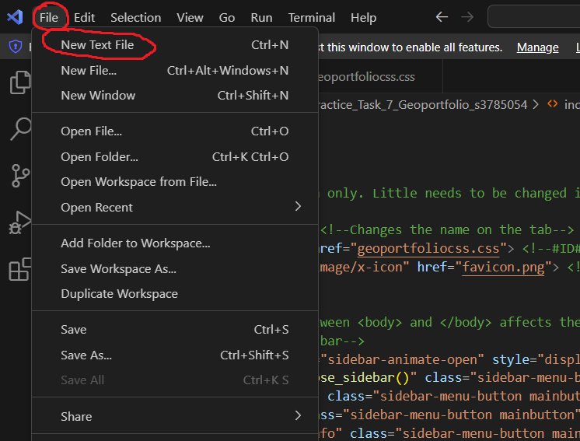
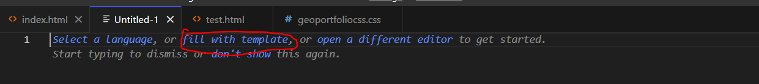

Slide 6
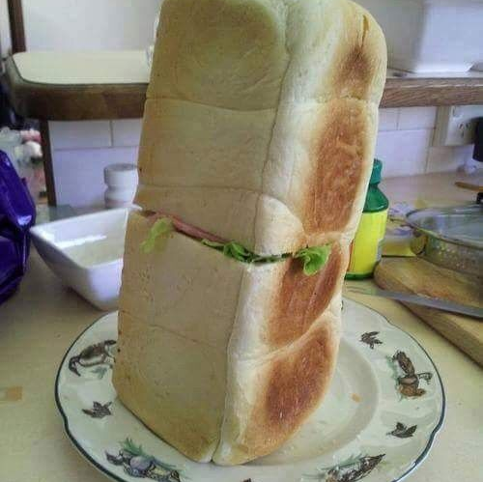
Designing the webpage is like making a sandwich
Sometimes the shop does it well, other times you can do it better!

Slide 7
Parts of the HTML sandwich
<html></html> - The “bread” of your sandwich: Everything has to be between the <html> and </html> tags.
<head></head> - The spread: All Metadata to go in here. Like butter/margarine spreads, you can modify it if you wish but can go without as the details that is not auto-generated it minor.
<style></style> - The secondary filling/salad: Any CSS/styling you want to apply to the items of the visuals is done here. Like salad, you can do this in a separate file just like how you can eat the salad on the side.
<body></body> - The primary filling: Everything that you want to be visually seen must be between these tags. Without the body, the sandwich will be two pieces of bread, some spread and condiments.
<script></script> - The condiments: The JavaScript programming to add animations or extra “flavour” to your page. Not necessarily needed but does add an extra kick to it.

Slide 8
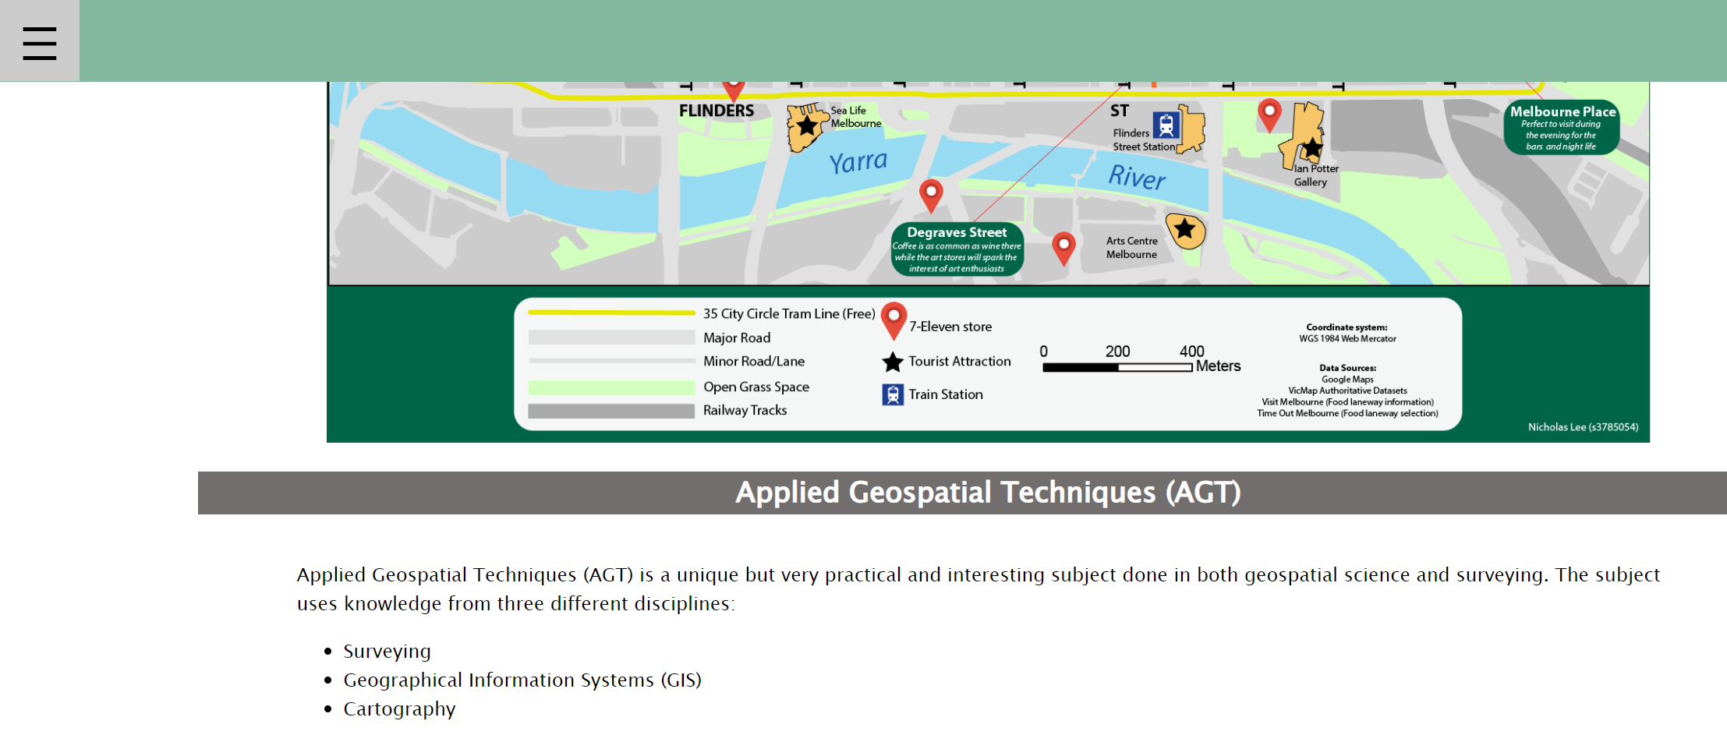
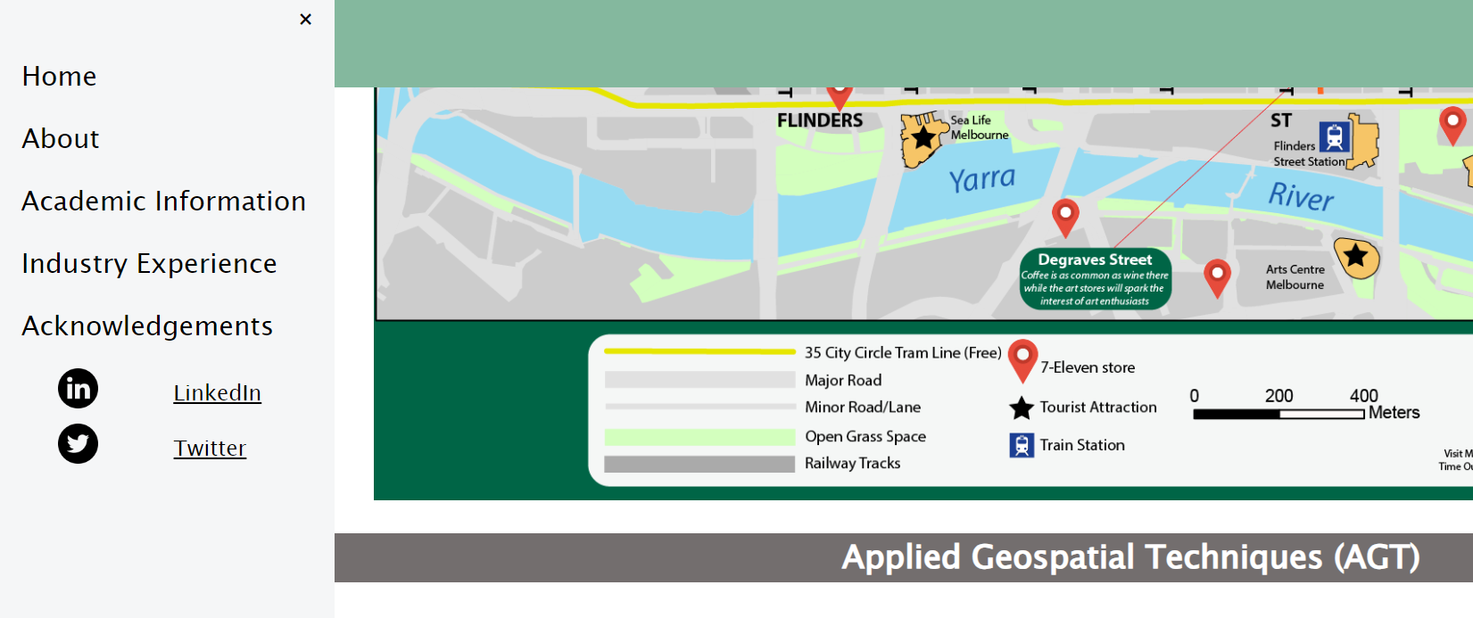
No <script>/JS applied
In this scenario, the buttons will not work as that is the only part of the page where JS has been applied.
Because the hamburger ☰ icon needs JS to be used to open the navigation menu, there is no navigation menu by default!

Slide 9


No <body>/content applied
No <body> tag = No content on the page

Slide 10

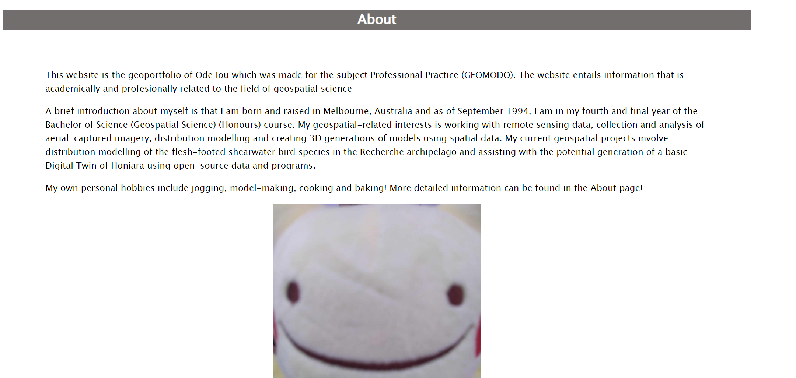
Full HTML and CSS applied

Slide 11
Head - <head> </head>
<head> <!--Contains Metadata only. Little needs to be changed in this section-->
<meta charset="utf-8">
<title>Geoportfolio</title> <!--Changes the name on the tab-->
<link rel="stylesheet" href="geoportfoliocss.css"> <!--#ID# #CSS# Put the name of your CSS document and file extension in href e.g. href="geoportfolio.css"-->
<link rel="icon" type="image/x-icon" href="favicon.png"> <!--#ID# #FAVICON# This changes the picture shown on the tab. Change the file name under href to your desired image e.g. href="favicon.png"-->
</head>

Slide 12
Body - <body> </body>
Control + F these keywords
<div class="about">
<div class="bar"><h2>Cartography</h2></div> - The h2 bars I created are used for larger headings
<div class="bar"><h3>Melbourne Map: All 7-11 locations in Melbourne City</h3></div> - The h3 bars I created are used for larger headings

Slide 13
CSS – Cascade Styling Sheet
Allows you to modify all HTML classes and IDs at the same time on the separate file.
May seem a bit counter-intuitive but helps keep your HTML code very tidy and allows for batch editing rather than needing to go to the separate divs to modify each section individually.
Code follows a different format than HTML.
Classes and IDs need to be contained in these brackets {}.
CSS functions usually go function: specifications;
CSS functions need to end in a semi-colon as seen in the sample text on the next slide.

Slide 14
CSS sample text
Class (note the dot point)
ID (note the hashtag)
.self-portrait{
height: 500px;
width: auto;
margin-left: auto;
margin-right: auto;
display:block;
}
#attribution-table{
margin-left: auto;
margin-right: auto;
}

Slide 15
CSS sample text continued
.self-portrait{
height: 500px; - Creates a height of 500px
width: auto; - Width will be automatically applied based on the height. Image will still keep default proportions but is actual size is reliant on height.
margin-left: auto; - Left side of margin will be automatically calculated
margin-right: auto; - Right side of margin will be automatically calculated.
display:block; - Displays the element/object like its own paragraph and will take up the entire width of the page placement wise.
}

Slide 16
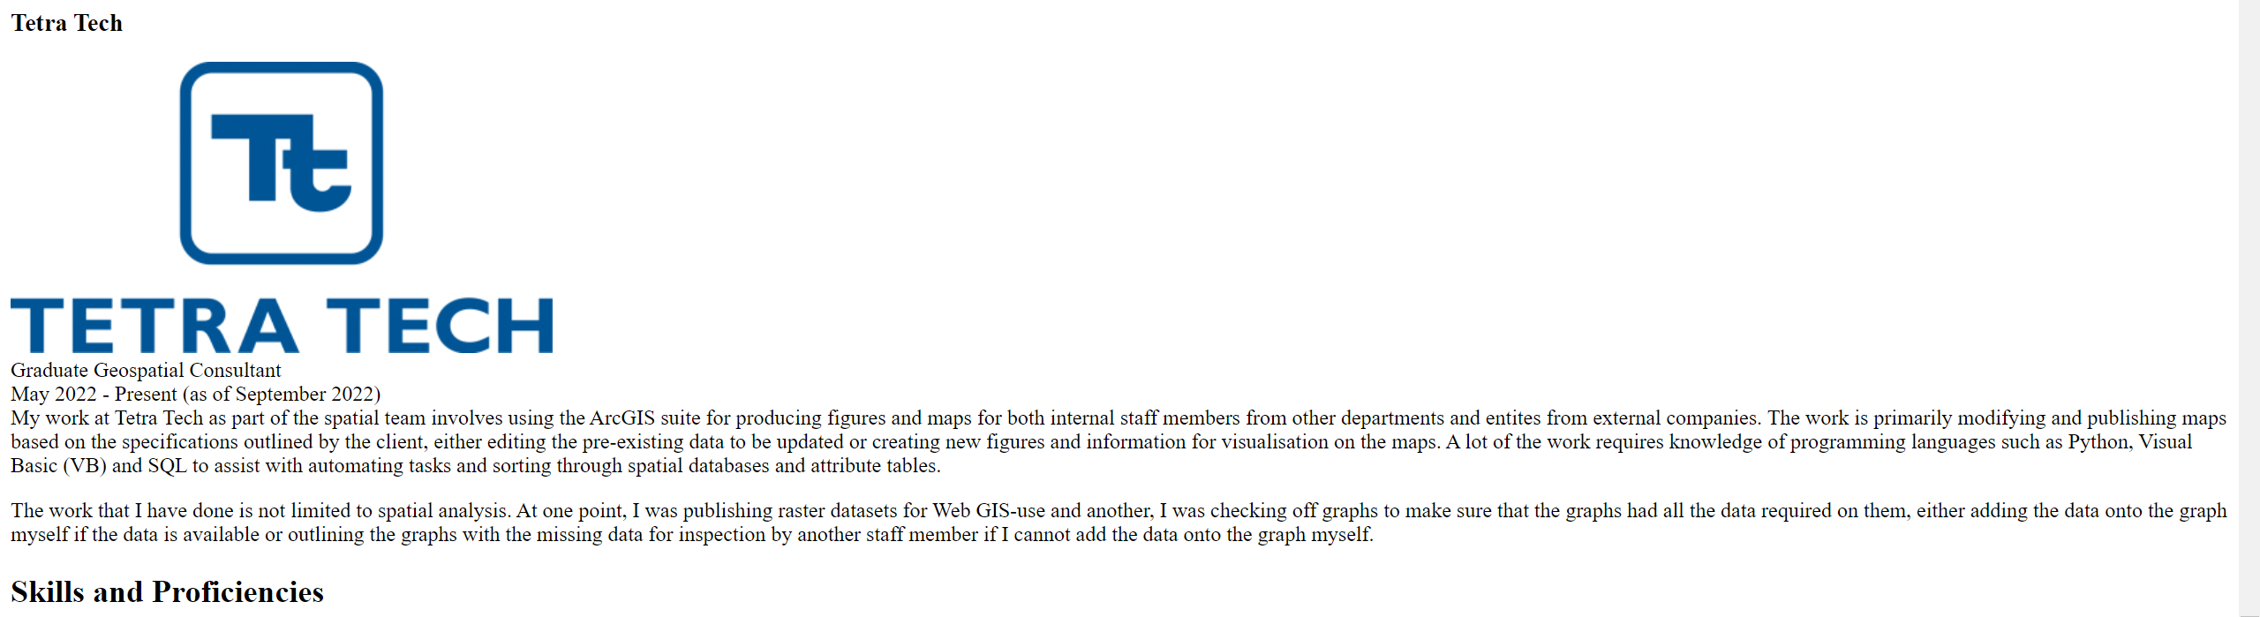
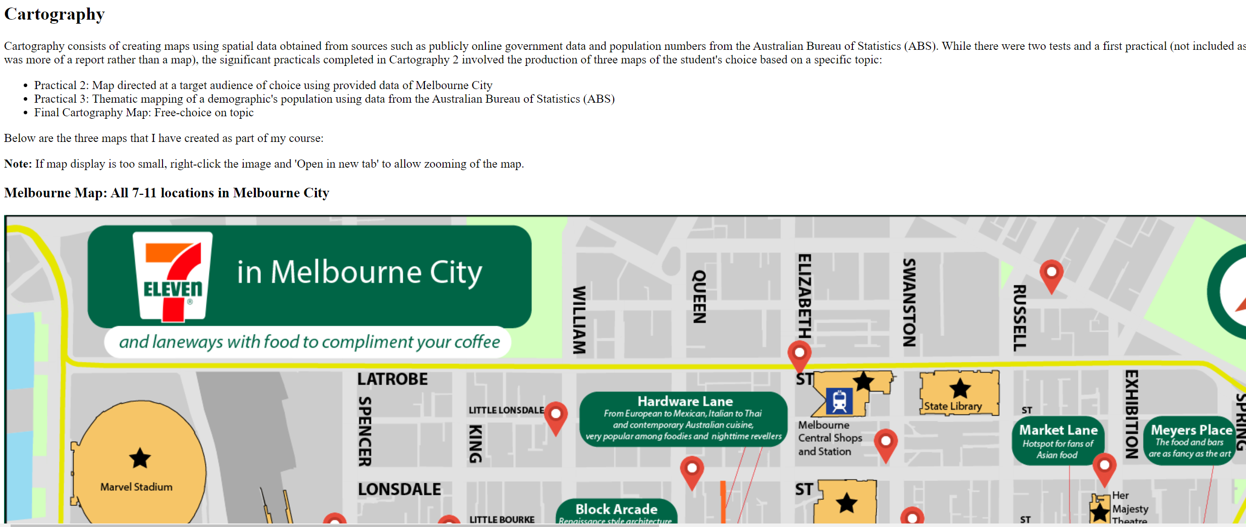
No <head>/CSS applied
Text defaults to Times New Roman and images are all over the place.
You can technically apply CSS in the HTML body but it will make the code very cluttered and messy.
That is why we use a CSS file!

Slide 17
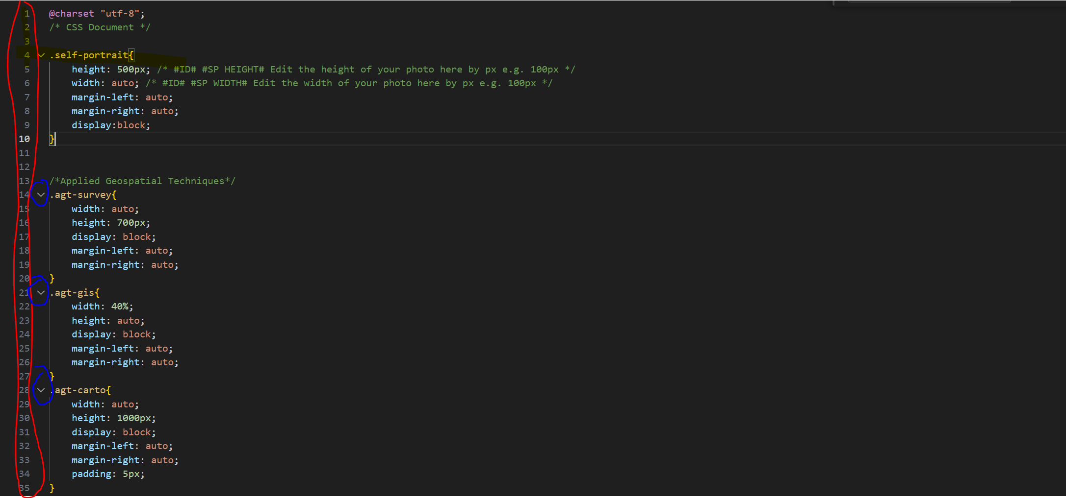
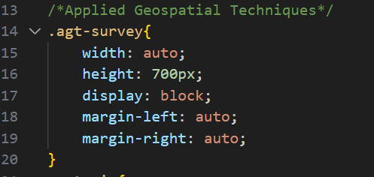
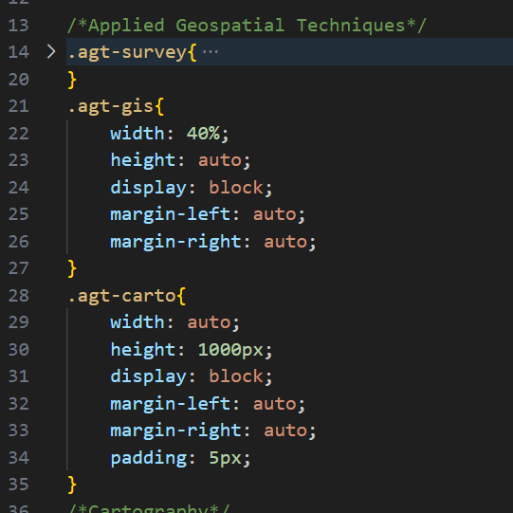
Hiding text

Slide 18
Important contents of my template
Index.html – Main file that contains all the content and text of the Geoportfolio.
geoportfoliocss.css – CSS file of all the CSS used to style the Geoportfolio page.
Sandbox.html – Duplicate of index.html used for testing and playing around without risking damage to the index.html template. Can also be used for comparing text to see if something could work or if something doesn’t work.
https://text-compare.com/ - Use this to compare between the two HTML files: The original index.html and your modified version

Slide 19
Ctrl + F shortcuts for navigating my HTML template
To jump through all of them, they will all be marked #ID#.
#CSS# - I provided a sample CSS file but if you want to use your own one, you will need to change the CSS name to the one of your new CSS file
#FAVICON# - To change the picture of the tab image
#NAME# - Change the name to YOUR name
#LINKEDIN# - Change the link to one of YOUR LinkedIn profile
#INTROHEADING# - Change intro heading bar text here
#SELFPORTRAIT# - Change to be your picture
#SUBJECT# - Change text to fit your subject and information.
#PICTURE# - Change to a picture of your assignment or company logo. Will be outlined in the comment
#COMPANY# - Change the company name to one you worked at
#JOB# - Change the position to one you worked at
#SKILLS# - Change the skills you have.
#CREDITS# - Change the credits and attribution based on your own personal use.
#COMPINFO# - Change compilation information based on your own personal use.
#FOOTER# - Change footer information

Slide 20
Ctrl + F shortcuts for navigating my CSS template
To jump through all of them, they will all be marked #ID#.
#START DNT# - Start of the DO NOT TOUCH (DNT) part of my CSS. Mostly a formality but modifying the CSS in this section may (likely) affect the display of your Geoportfolio.
#END DNT# - End of the DO NOT TOUCH (DNT) part of my CSS. Mostly a formality but modifying the CSS in this section may (likely) affect the display of your Geoportfolio.
#COLOR# - Change the colour of the header at the top of the page.
#FONT# - Changes the font of EVERYTHING.
#LANDSCAPE# - Class used to assign to all sizes of landscape images
#PORTRAIT# - Class used to assign to all sizes of portrait images

Slide 21
Useful HTML notes
White text indicates that it will be text that shows on the page
<!-- Comment --> - Text between <!-- --> will be recognised as a comment. Very good for leaving notes on your work.
<p>Paragraph text</p> - Creates a new paragraph.
<br> - Breakline that puts the next text onto a new line. However, there is no spacing unlike a paragraph’s text.
<div class=“class” id=“id”></div> - Creates a container. Contents of the container is based on the text and images inside and the size and specifications is based on the CSS applied to the class and ID.
<img src="self-portrait.jpg" class="self-portrait"> - Inserts an image of the file self-portrait.jpg with specifications of the class self-portrait on the CSS.

Slide 22
Useful CSS
Do NOT forget to end lines on CSS with a semi-colon (;) as seen in the sample code.
/* Comment */ - Text between /* */ will be counted as a comment. Very good for leaving notes on your work
#id – ID for CSS but can only be applied to ONE object e.g. a div/box.
.class – Same as an ID but can be applied to MULTIPLE objects.
Z-index: Similar to the “Send backwards” and “Bring forward” with images on Word/PowerPoint. Positive numbers will bring objects forward/on top while negative numbers will bring objects lower e.g. z-index: -1;

Slide 23
Tips from personal experience
When naming classes and IDs, create something unique and easy to remember. Naming it something basic (e.g. box) will make ALL contents with a class of box be affected. Naming it something too long (e.g. landscape images for only Applied Geospatial Techniques) will be a chore to type.
Comment, Comment, COMMENT! Leave comments on your code so you know what each code does. This will be helpful in case you need to make a change.
If certain code isn’t working, Inspect Element (Right click and press Inspect) can have the code be modified while the web page is open as seen in the next slide)
Alternatively, create a new HTML document and play around with just the code causing issues there. That can isolate the issue while not having to worry about other parts of your webpage.

Slide 24
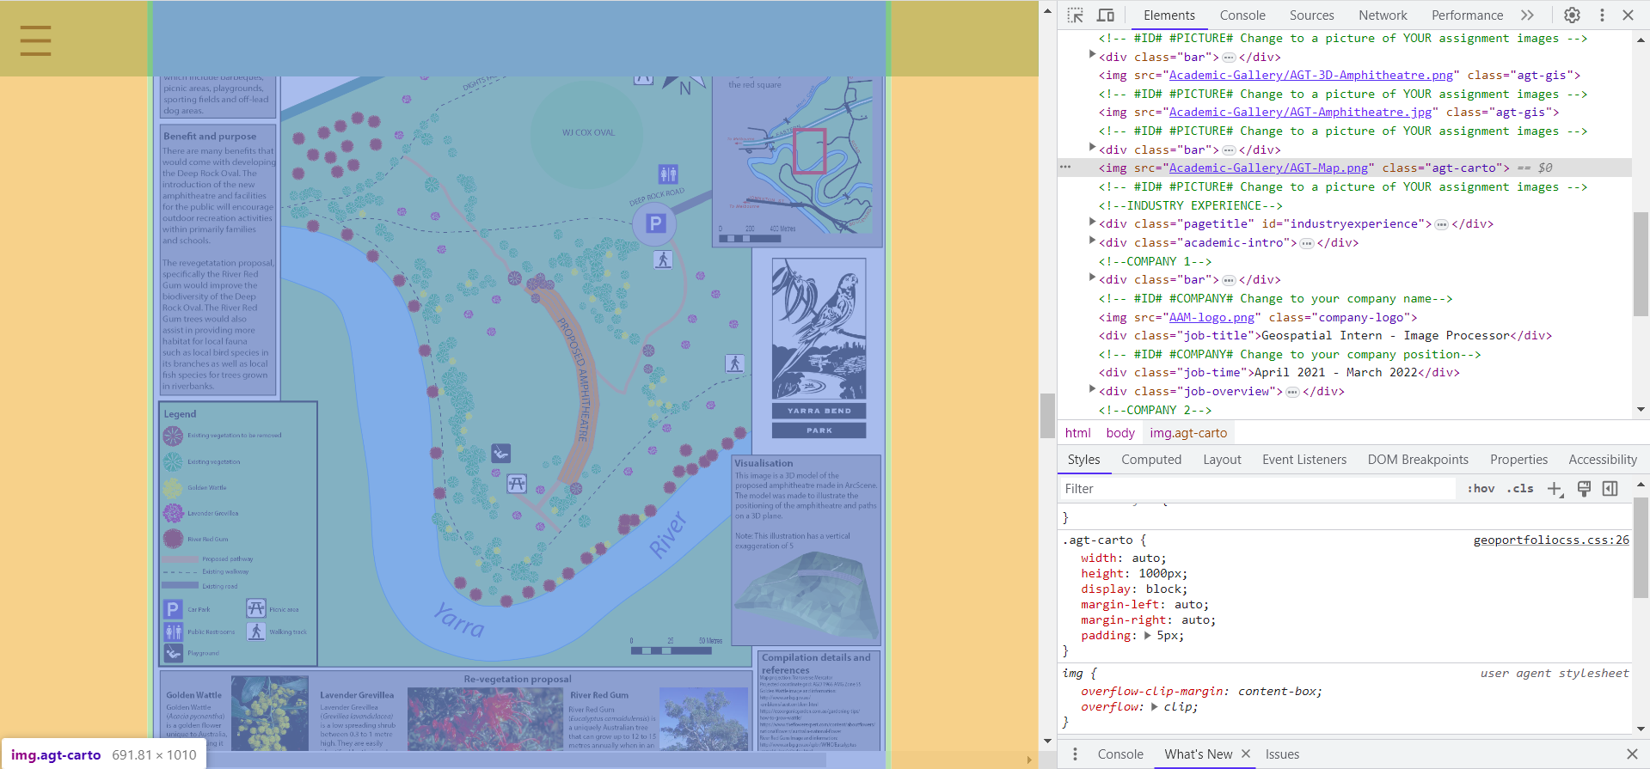

Slide 25




Good websites
Flaticon: Good for obtaining vector images for icons (Account and attribution required)
https://www.flaticon.com/
w3schools: Good for HTML and CSS tutorials
https://www.w3schools.com/
Stack Overflow: Good for searching for some issues (assuming a similar problem has been encountered and that there is a helpful response).
https://stackoverflow.com/

Slide 26

Sample Geoportfolios from previous students to help guide you
https://pupper42.github.io/ky_portfolio_web/#/
https://www.olivertrembearthsgeoportfolio.com/

Slide 27

Publishing your webmap
This is done using GitHub where you need to make an account using your personal email.
Instructions are found in the link below:
https://rmit.instructure.com/courses/112364/assignments/848700
WARNING: GitHub can be finicky so try and publish earlier than later.

Slide 28


Well done for today!
Have a nice break or a cup of tea!
Any questions?

